Slide 1
SHIFT REGISTERS
&
RIPPLE COUNTERS
By
Shoaib Akhter https://youtu.be/Y9qb9yKnEgw

Slide 2
Shift Registers:
A shift register is a digital memory circuit found in calculators, computers, and data-processing systems. Bits (binary digits) enter the shift register at one end and emerge from the other end. The two ends are called left and right. Flip flops, also known as bistable gates, store and process the data.
Basic flip flop is used in the register is D ff.

Slide 3
Shift Registers:
We use shift register so that our program is not complex because of Addition and Subtraction again and again because of Multiplication and Division.
A shift register is used to implement arithmetic operations.
Examples:
Left Shift (0001 → 0010 → 0100 → 1000)
This is happening by Multiply by 2
Right Shift (1000 → 0100 → 0010 → 0001)
This is happening by Division by 2

Slide 4
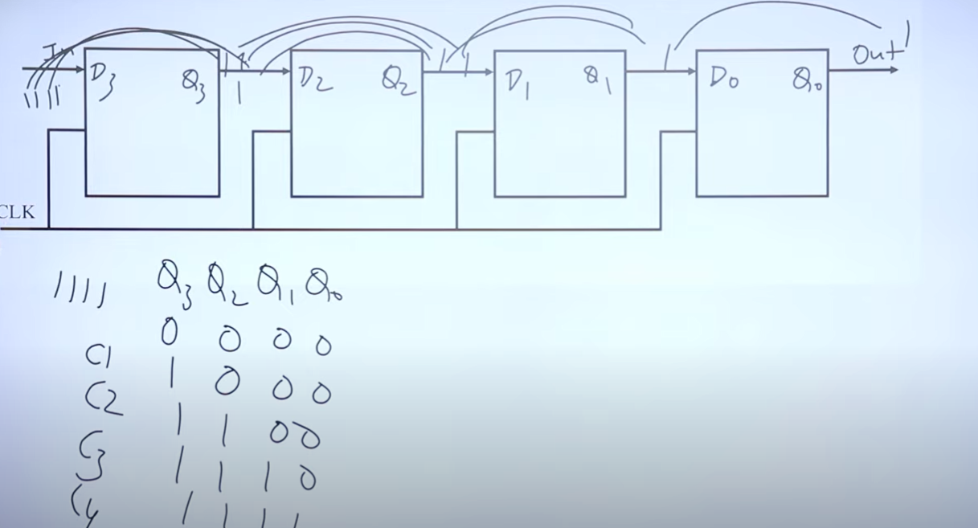
Serial Input and Serial Output (SISO)

Slide 5
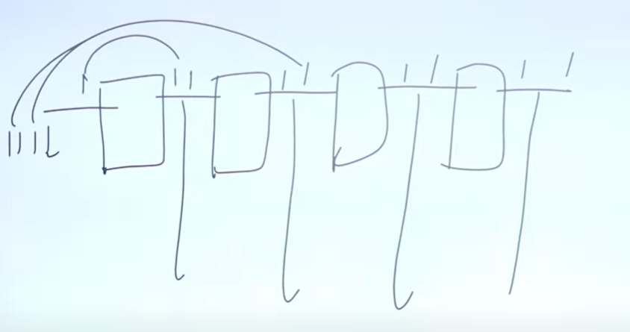
SIPO , PISO , PIPO:

Slide 6
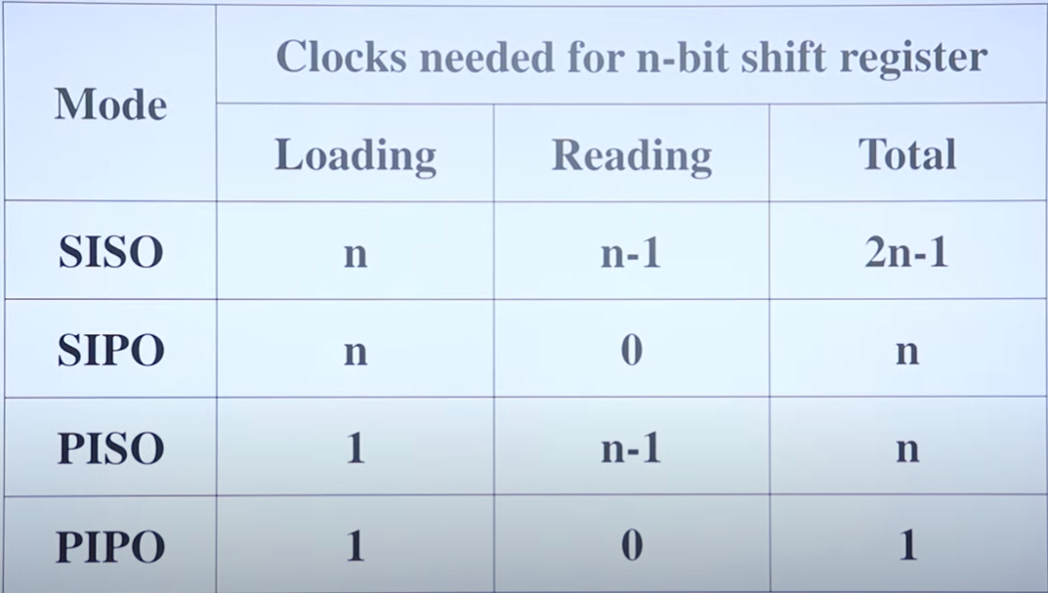

Slide 7
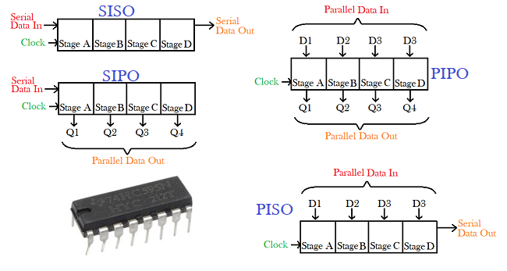

Slide 8
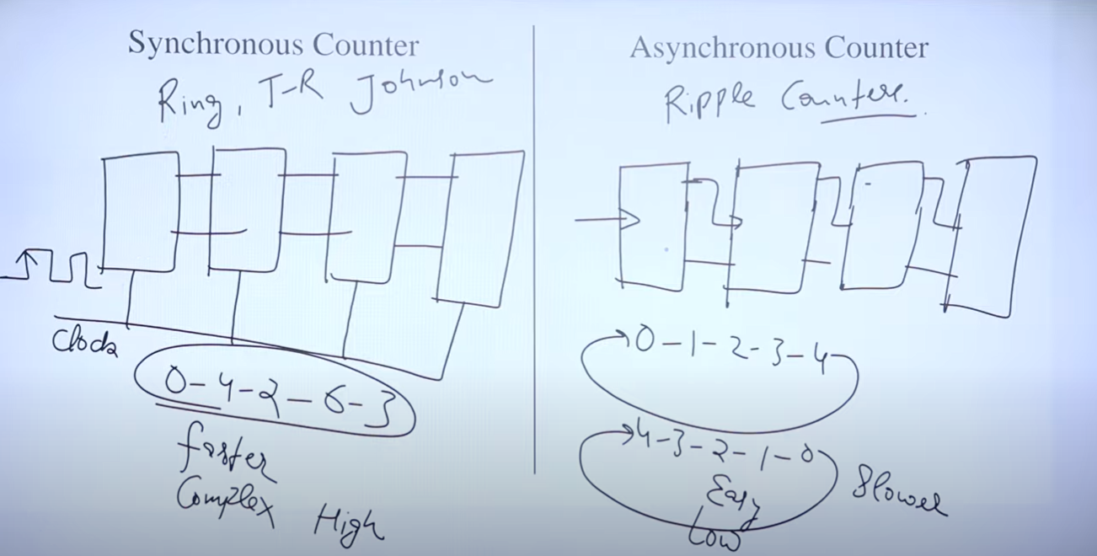
Ripple Counters:

Slide 9
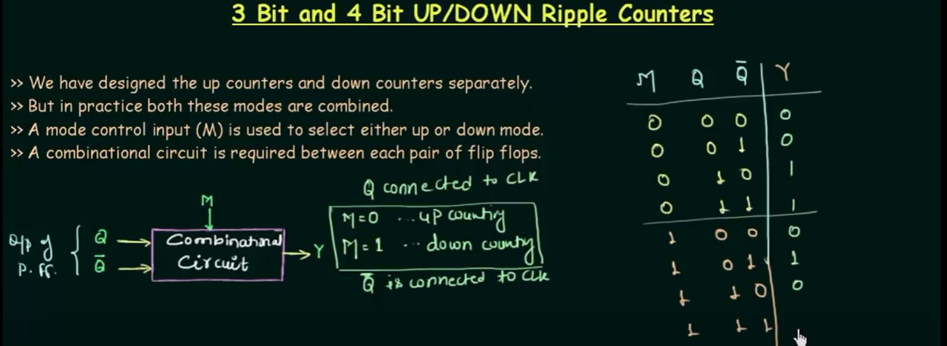
Ripple Counters:

Slide 10
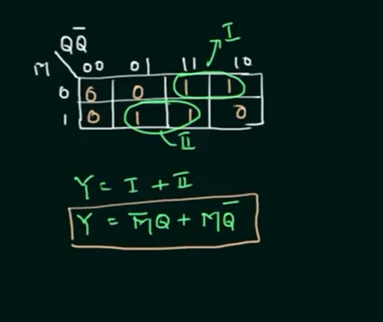
Ripple Counters:

Slide 11
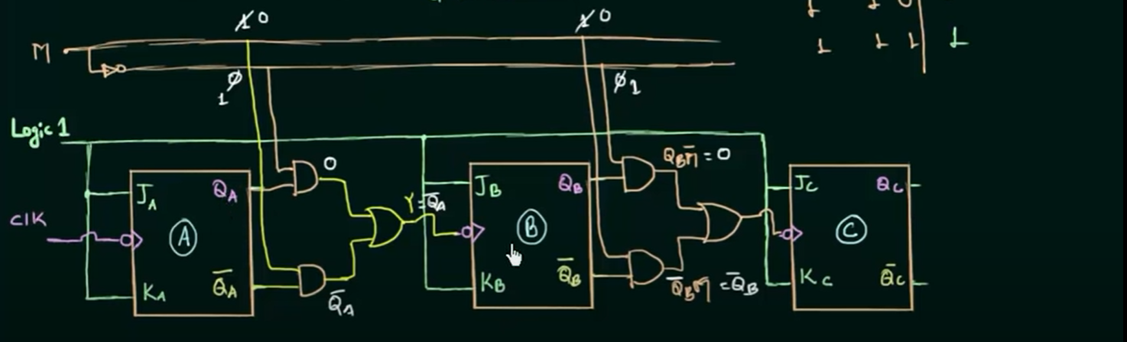
Ripple Counters:

Slide 12
THANK YOU
Generated By
Shoaib Akhter

